Slide 1
機器學習應用於信用卡詐欺的績效評估
Performance evaluation of machine learning applications detecting credit card fraud
312707033包坤達、313707048郭奕伶
20240419 TEN MFS.key

Slide 2
Motivation
Data
Design of analysis
Empirucal results
Conclusion
IDA Template

Slide 3
Movitation

Slide 4
Motivation
Motivation
Credit card fraud detection is a challenging and typical binary classification problem that involves handling highly imbalanced data.
Researching this problem helps demonstrate the potential of machine learning algorithms in the financial sector, particularly in improving model performance and addressing data imbalance issues.
IDA Template

Slide 5
Data

Slide 6
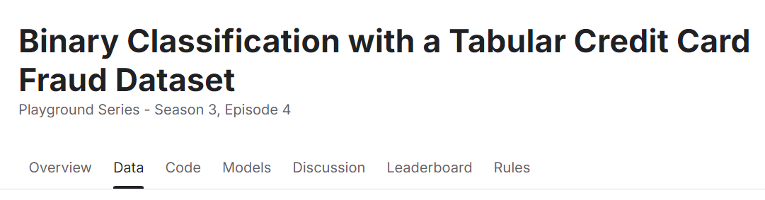
Data
Link: https://www.kaggle.com/competitions/playground-series-s3e4
Variables:
id: A unique identifier for each transaction.
Time: The relative time of the transaction (in seconds), based on the first transaction.
V1~V28: Features transformed through Principal Component Analysis (PCA) to protect sensitive data.
Amount: The transaction amount.
Class: Label that we predict (Class=0:no fraud, otherwise it indicates fraud)

Slide 7
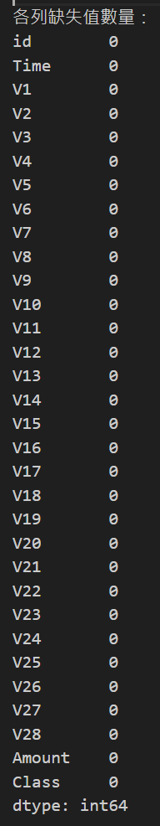
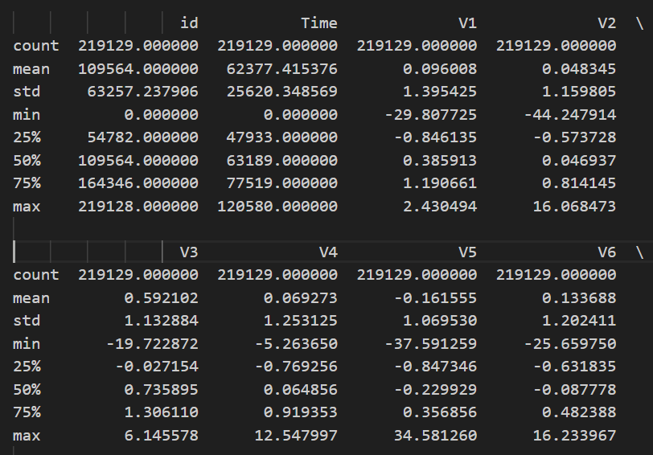
Total transaction datasets:219129

Slide 8
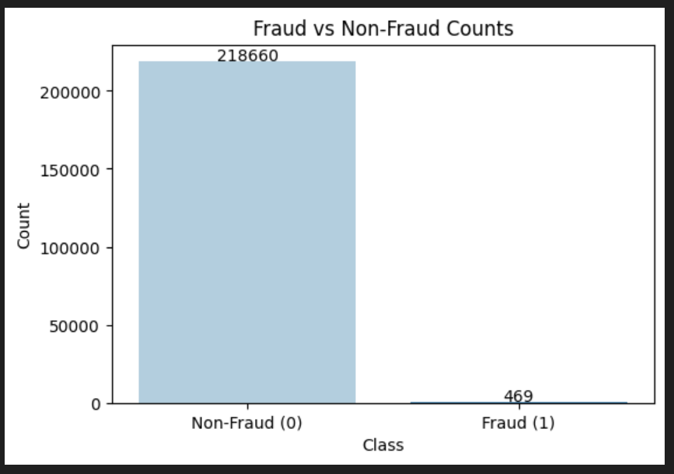
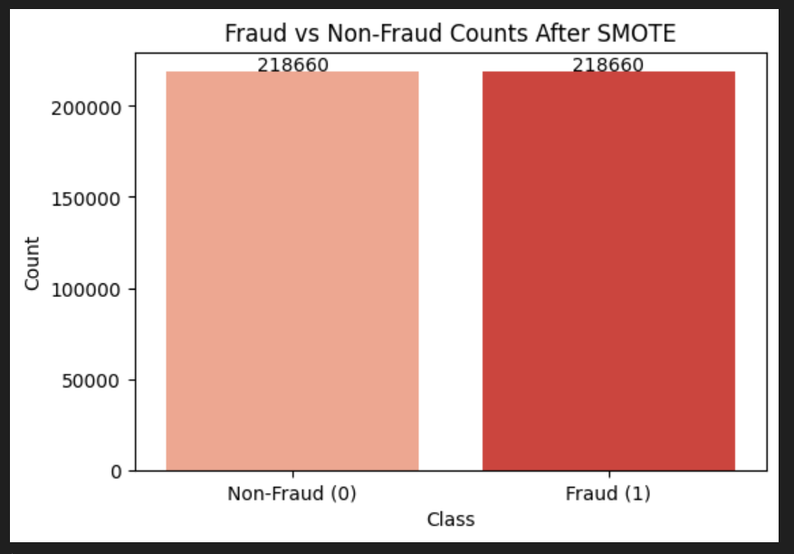
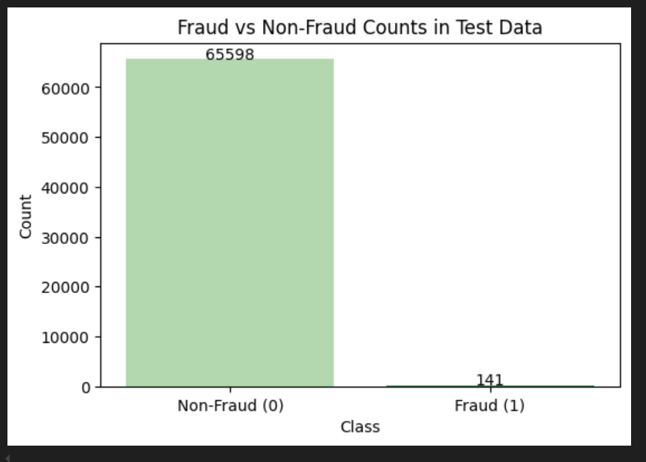
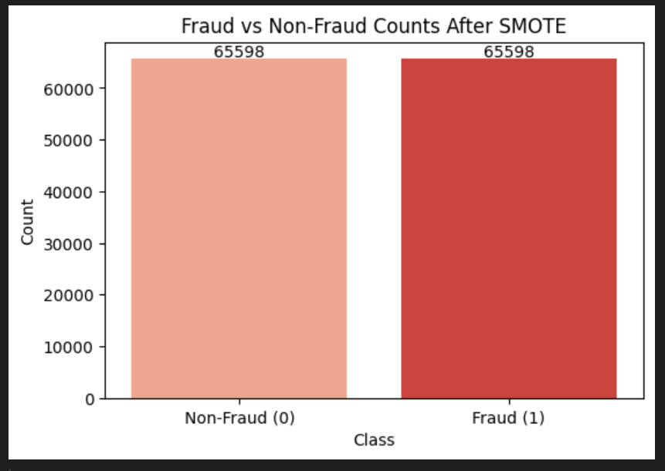
Training data:
SMOTE
→
Test dataset

Slide 9
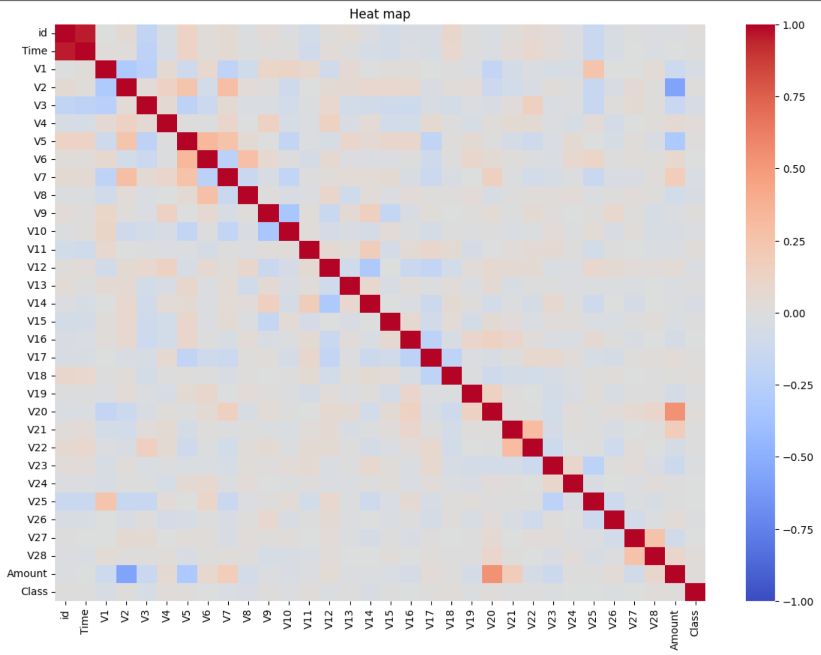

Slide 10
Design of analysis

Slide 11
Motivation
How to do
Model used:Decision tree,RandomForest,XGBoost,KNN
Model | Training set | Testing set
Decision tree | 70% Data (SMOTE method) | 30% Data
RandomForest
XGBoost
KNN
IDA Template

Slide 12
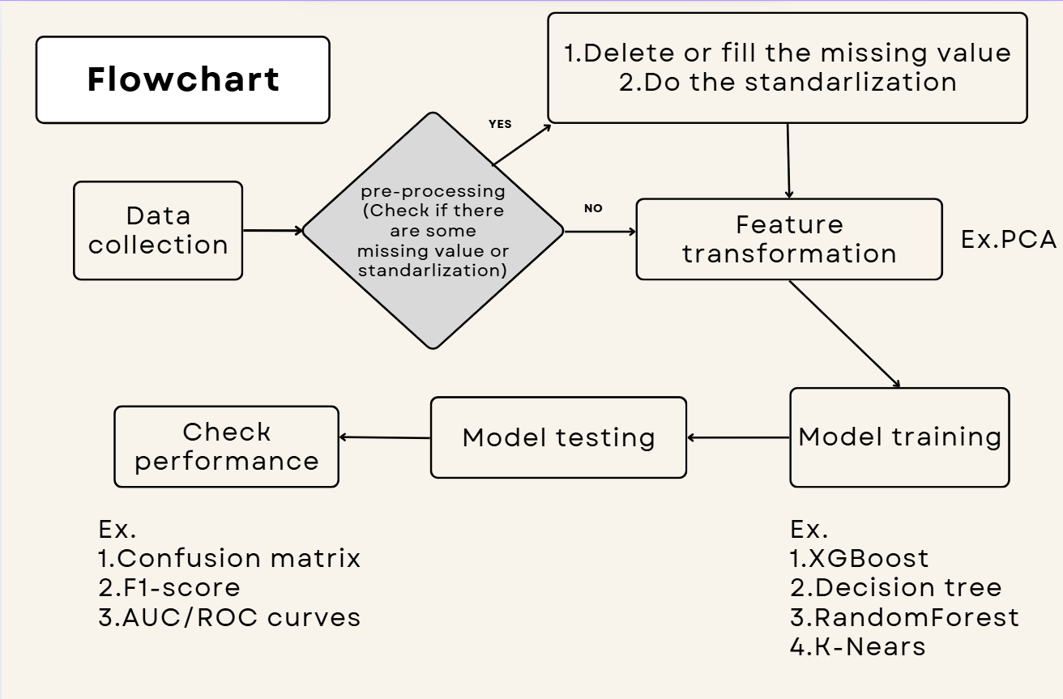

Slide 13
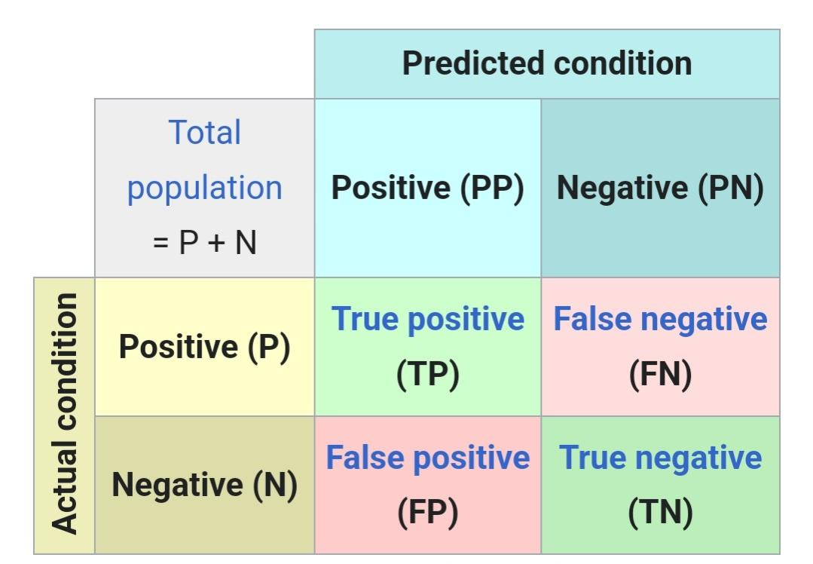
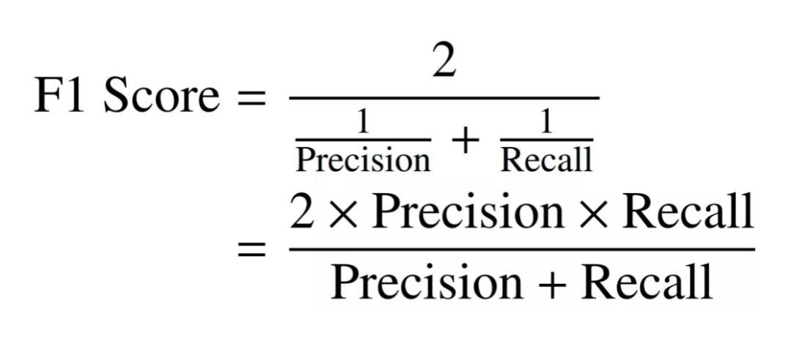
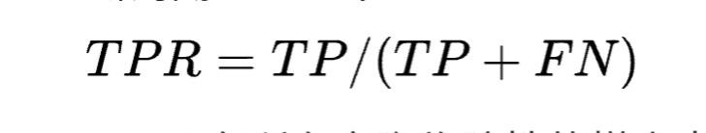
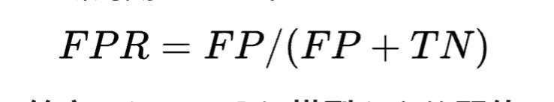
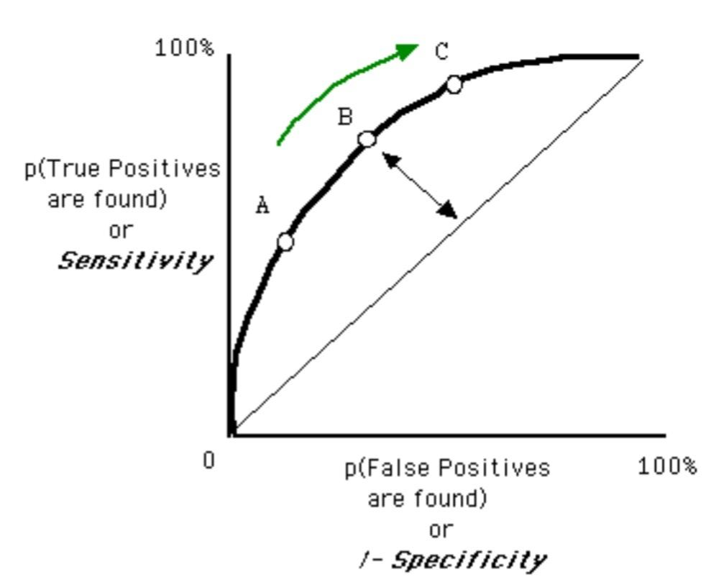
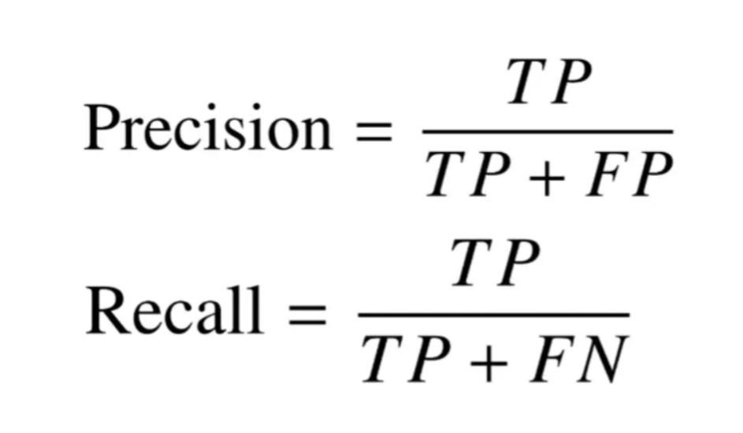
Performance
1.Confusion matrix. 2.F1-score. 3.AUC/ROC curve

Slide 14
Results

Slide 15
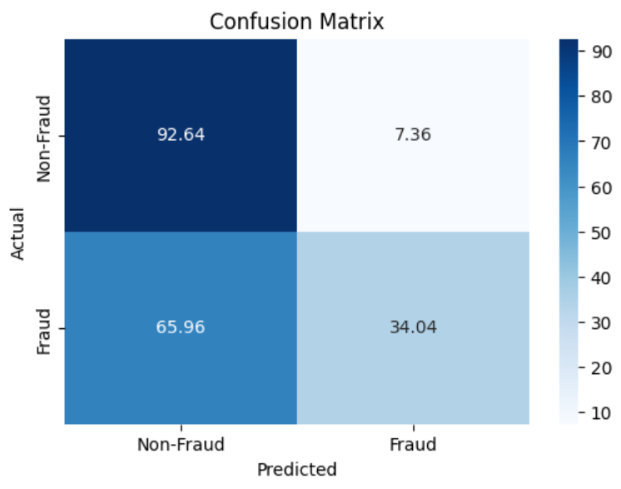
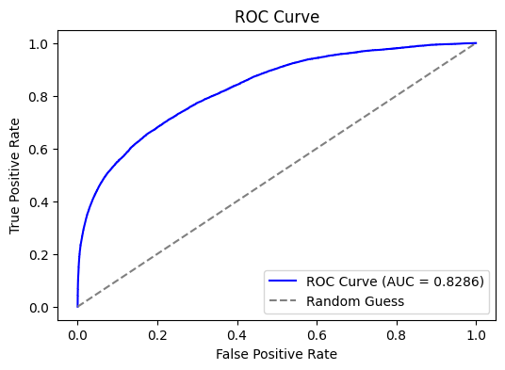
Empirical Results
XGBoost
Evaluation Metrics
Accuracy: 0.7150
Precision: 0.8725
Recall: 0.5036
F1 score: 0.6386
AUC: 0.8286
IDA Template

Slide 16
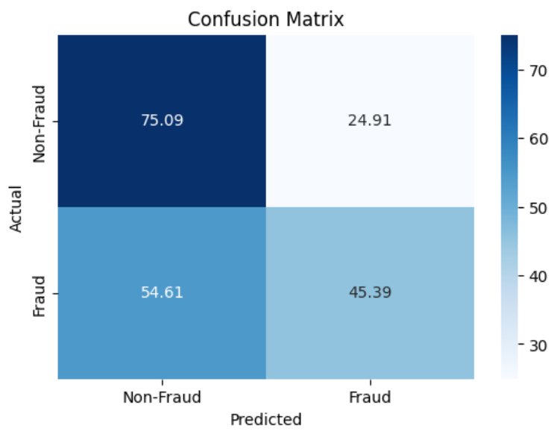
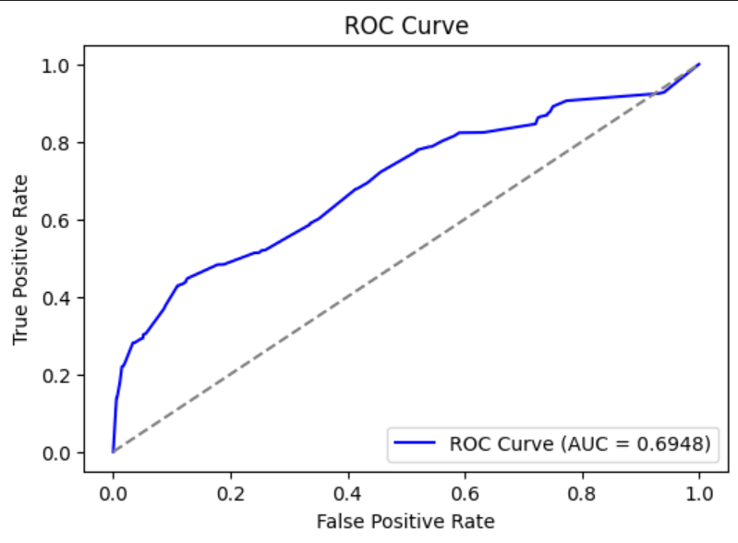
Empirical Results
Decision Tree
Evaluation Metrics
Accuracy: 0.6323
Precision: 0.6734
Recall: 0.5138
F1 score: 0.5829
AUC: 0.6948
IDA Template

Slide 17
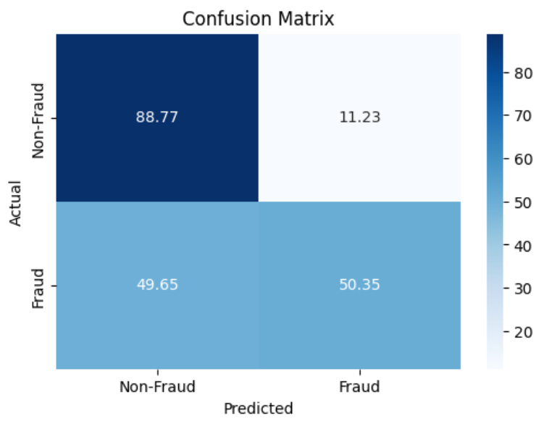
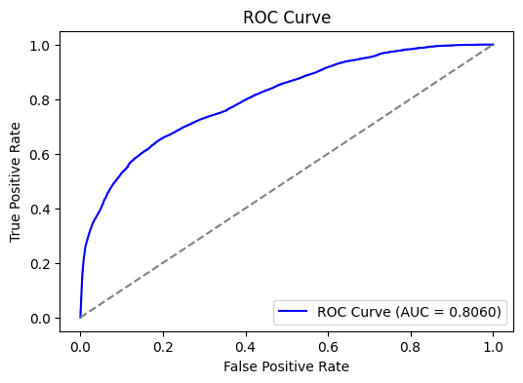
Empirical Results
Random Forest
Evaluation Metrics
Accuracy: 0.7180
Precision: 0.8300
Recall: 0.5483
F1 score: 0.6604
AUC: 0.8060
IDA Template

Slide 18
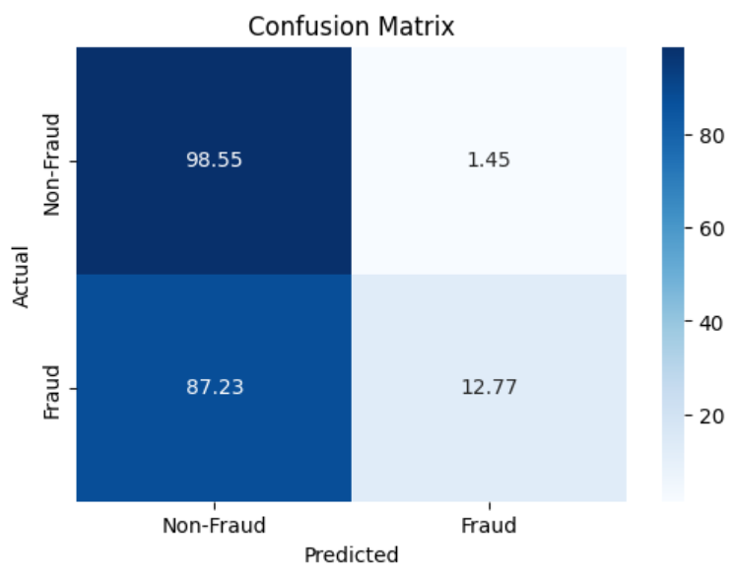
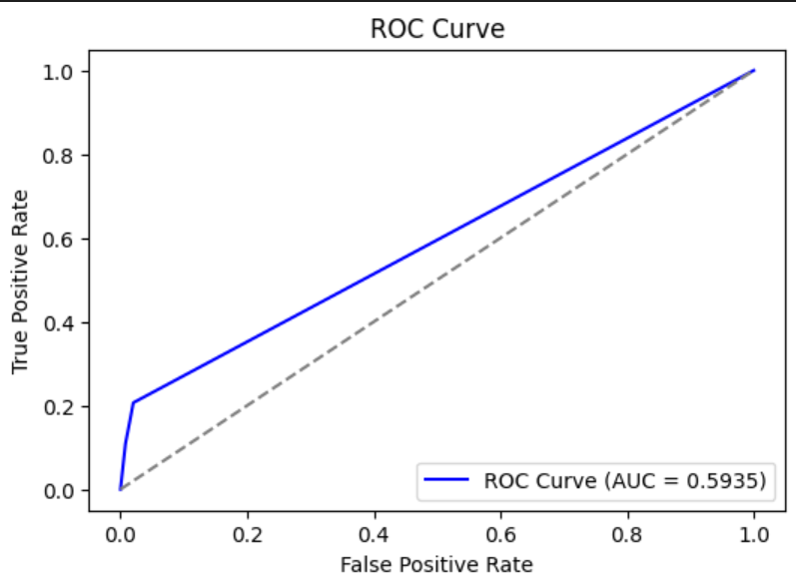
Empirical Results
KNN
Evaluation Metrics
Accuracy: 0.5731
Precision: 0.9172
Recall: 0.1606
F1 score: 0.2734
AUC: 0.5935
IDA Template

Slide 19
Performance
Conclusion
 | XGBoost | Decision tree | Random forest | KNN
Accuracy | 0.7150 | 0.6323 | 0.7180 | 0.5731
Precision | 0.8725 | 0.6734 | 0.8300 | 0.9172
Recall | 0.5036 | 0.5138 | 0.5483 | 0.1606
F1 score | 0.6386 | 0.5829 | 0.6604 | 0.2734
AUC | 0.8286 | 0.6948 | 0.8060 | 0.5935
XGBoost is the suitable choice as it provides the highest AUC and strong Precision, with stable performance across other metrics.
IDA Template

Slide 20
Thanks for listening!

